Slide 1
ME FYP Progress Report
20/08/2021
Cheung Hiu Ching, Athena
Fung Ka Chun, Tim
Liu Sum Yin, Kylie

Slide 2
TABLE OF CONTENTS
01
03
Introduction
Preparation
02
04
Planning/Schedule
Q & A
Introduce the missions of our VTOL UAV
Present our own ideas & our preparation
Gantt chart from Aug to Oct 2021
Sincerely seeking for any comments and advices

Slide 3
01
Introduction
Introduce the missions or requirements of our VTOL UAV

Slide 4
Introduction: Missions/requirements of our VTOL UAV
Referring to “v11.PSTS (revised prototypes and samples quantity).pdf” P.3, 8-9:
Air speed: 15 to 20 m/s
Flight altitude: 100 to 500 m
Flight duration: > 30 min (aim: around 1 hour)
Flight range: > 30 km
Corresponding lift/drag ratio > 5
Hover efficiency: within 30% of the ideal power loading
Effective load fraction > 30% of the gross weight

Slide 5
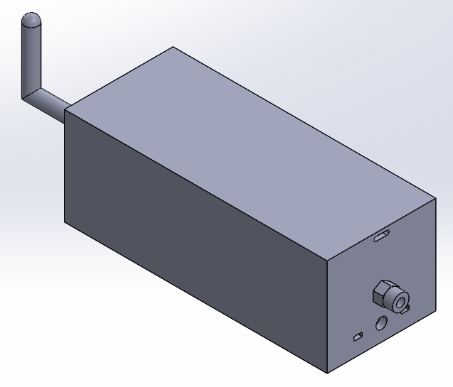
Introduction: Missions/requirements of our VTOL UAV
Payload:
Dimensions: around 191*79*71 (mm) (exclude antenna)
Weight: around 1 kg
Estimated max. dimensions of our VTOL: 1700*1100*160 (mm)
Layout: combination of fixed wing and rotors
Type of power supply: electric brushless motor
Major material: wood & carbon fiber

Slide 6
Planning/Schedule
02
Gantt chart from Aug to Oct 2021

Slide 7
Gantt chart: from Aug to Dec 2021
 | Aug W1-2 | Aug W3-4 | Sep W1-2 | Sep W3-4 | Oct W1-2 | Oct W3-4 | Nov W1-2 | Nov W3-4 | Dec W1-2 | Dec W3-4
Self-Learning
Build VTOL X8
Draw CAD
Do simulation & calculation
Build our VTOL
Write report
Midterm & Exam
1 Aug - 22 Aug
23 Aug - 16 Oct
1 Sep - 23 Oct
22 Aug - 18 Sep
17 Oct - 31 Dec
1 Sep - 31 Dec
2 Dec - 17 Dec

Slide 8
Preparation
03
Present our own ideas & preparation

Slide 9
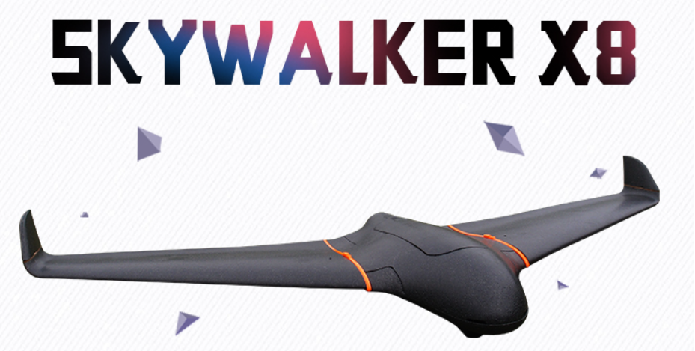
Geometry design
Referring to Skywalker X8:
- Delta wing
- Max. cabin capacity: 630*250*105 (mm) → √ Payload 191*79*71 (mm)
- No tail
https://item.taobao.com/item.htm?spm=a1z0d.6639537.1997196601.26.60ce58861nOiAH&id=537073127745

Slide 10
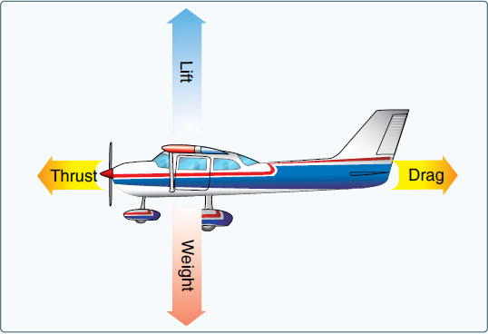
Equations for simulation/analysis
Force acting on our UAV

Slide 11
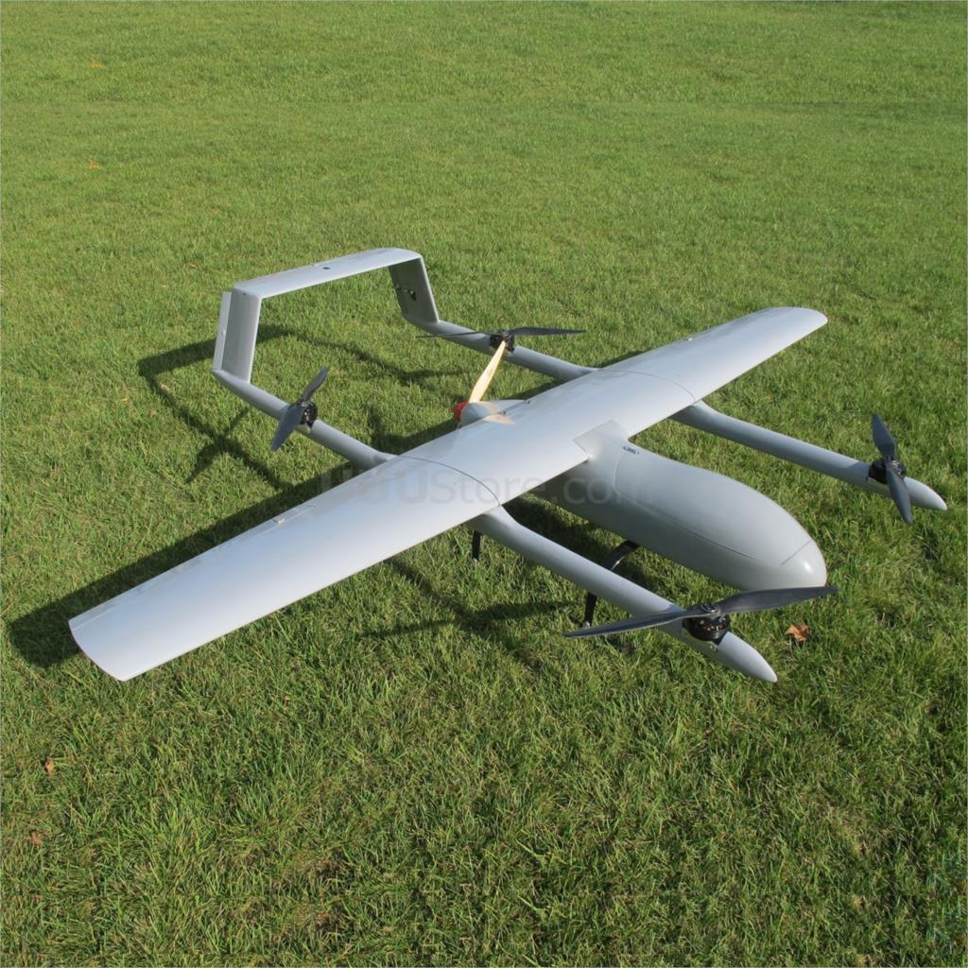
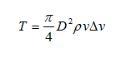
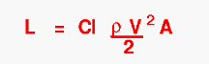
Equations for simulation/analysis
Take-off Weight
In our design,
$W_{0}$ = $W_{payload}$+ $W_{battery}$+ $W_{empty}$, where $W_{0}$ is constant in the whole mission
Lift
1st stage lift (vertical take-off) caused by thrust of rotors
2nd stage lift (crucial flying) caused by thrust of rotors plus wing

Slide 12
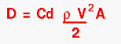
Equations for simulation/analysis
Thrust
Produced by propeller
Drag
1st stage drag(vertical take-off)
Reference Area: Top Area
2nd stage drag(crucial flying)
Reference Area: Frontal Area

Slide 13
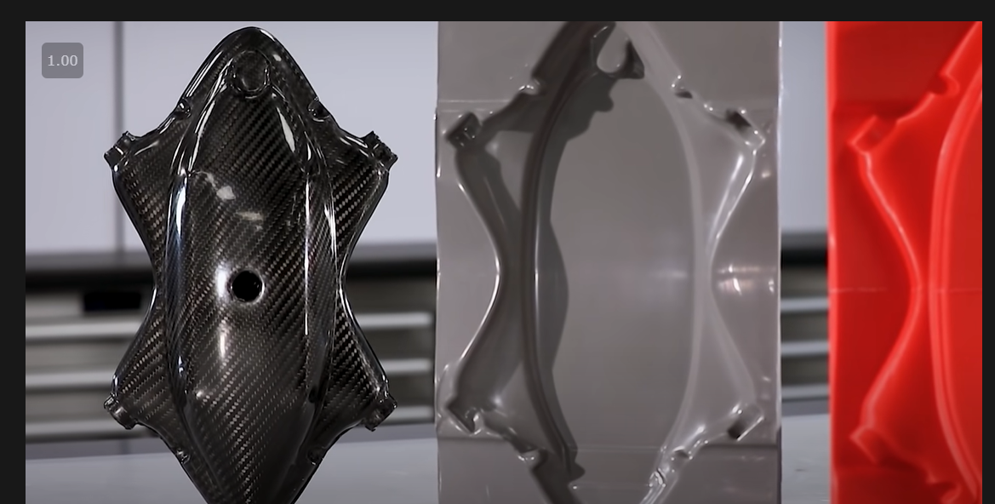
Manufacturing methods
Carbon fiber parts (outer shell)
- Mold: 3D printing
- Vacuum bag
Wooden parts (supporting components)
- Laser cutting

Slide 14
Q & A
04
Sincerely seeking for any comments and advices

Slide 15
Thank You

